Slide 1


CITS1003 Introduction to Cybersecurity [10] Critical Infrastructure and Cyberphysical Systems - 2
Dr David Glance

Slide 2
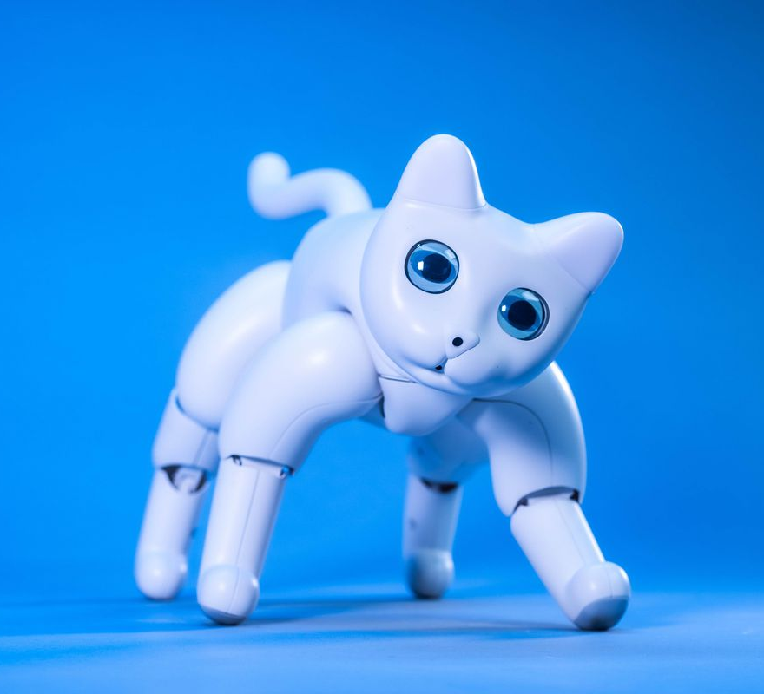
A unit about cats cybersecurity
MarsCat https://www.elephantrobotics.com/en/

Slide 3

3 things
Understand what Cyber Physical Systems are and how it relates to Critical Infrastructure
1
Understand the cybersecurity challenges of CPS
2
Examine risks and mitigations in Healthcare IoT, Cars
3

Slide 4
Critical Infrastructure
“Those physical facilities, supply chains, information technologies and communication networks which, if destroyed, degraded or rendered unavailable for an extended period, would significantly impact the social or economic wellbeing of the nation or affect Australia’s ability to conduct national defence and ensure national security”
Australian Government Critical Infrastructure Centre
Examples include:
Water, Electricity, Gas supply
Telecommunication
Public Health
Agriculture
Financial Services
Transportation and Shipping

Slide 5
Technologies
Operational Technology (OT) refers to systems that are used to manage industrial operations
Industrial Control Systems (ICS) are the systems that are used to manage monitor and control systems. Usually of two types:
Continuous process control systems managed by programmable logic controllers (PLCs)
Discrete Process Control systems that may use PLCs but also batch process control devices
ICS are often managed by Supervisory Control and Data Acquisition (SCADA)

Slide 6
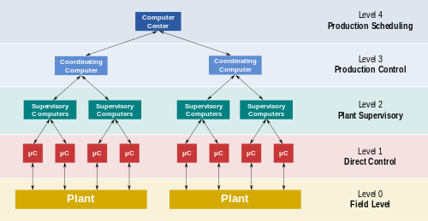
SCADA
0: sensors and control valves
1: I/O modules distributed electronic processors
2: Supervisory computers collecting data
3: Production control level
4: Production scheduling

Slide 7
SCADA Security Weaknesses
Not built with security in mind
Thought to be secure because they were isolated and not internet connected
No encryption
Security through obscurity – proprietary systems
Updates are not cryptographically secure

Slide 8
Case Study: Attack on Ukrainian Power Companies
2015 a cyber attack on the Ukrainian power grid shut power to 230,000 consumers for 1 – 6 hours
The attack was started through spear phishing with the BlackEnergy3 malware.
The phishing email opened a Word document that prompted the user to enable macros which then installed the malware.
This gave the attackers a backdoor
From the corporate network, the attackers got onto the network with the SCADA devices
They disabled the Uninterruptable Power Supplies
Flooded the call centre with a denial of service
Threw breaker switches for the power substations
They re-wrote the firmware for communications hardware in the substations
They then wiped operator terminals using malware called KillDisk

Slide 9
Attribution
The Ukrainians blamed Russia and the attack came during conflict between the two nations, no evidence was presented
The attacks happened immediately following kinetic (physical) attacks on substations providing power to Crimea and a Russian naval base. The subsequent attack was seen as retribution however - the preparation would have taken 6 months and so it is likely that the original motivation for hacking the power companies was for other reasons
Much more damage could have been done, including causing the power stations to explode
In these situations, there may be an element of any number of governments, or even criminal groups simply displaying their capabilities

Slide 10
Stuxnet
Stuxnet was discovered in 2010
Launched in 2005 against specific SCADA controlling uranium enrichment centrifuges in Iran
Initial target is Windows networks
Then specifically targets the PLC running Siemens Step 7 software
Causes the centrifuge to spin at a dangerously high speed eventually causing damage and inoperability
Masks activities by reporting a normal operating environment

Slide 11
Stuxnet 2
Infects computers via USB memory stick and so can cross air gaps but then uses a variety of other techniques to travel across networks
The malware only operates if it finds Siemens software and was coded initially to only target specific networks
However, a programming error meant it spread and was found infecting machines on the Internet
It involves a large number of zero days and this is unusual in malware
Related malware: Duqu and Flame

Slide 12
Stuxnet Attribution
It has been suggested that this attack was part of a joint US-Israel operation called Operation Olympic Games launched by US President Obama
Significant code similarities with code released by the Shadow Brokers in 2017 which purported to include an “exploit development framework” developed by the Equation Group, a cybersecurity development team at the NSA in the USA
It is also thought that only a nation state actor would have invested the time and resources in mounting this attack
A more recent attack cutting power to Iranian nuclear power facilities may have been another targeted attack by a nation state

Slide 13
Cyberphysical Systems
Cyberphysical systems (CPS) are the combination of sensors, communications, processing and control systems to interface with and control the physical environment.
Related to IoT, Smart Cities, (Smart Anything)
Examples include ICS, smart grids, autonomous vehicles, robots, healthcare systems
Communication is via a number of different protocols but will increasingly rely on 5G+ technologies
Involves M2M (Machine-to-Machine) communication

Slide 14
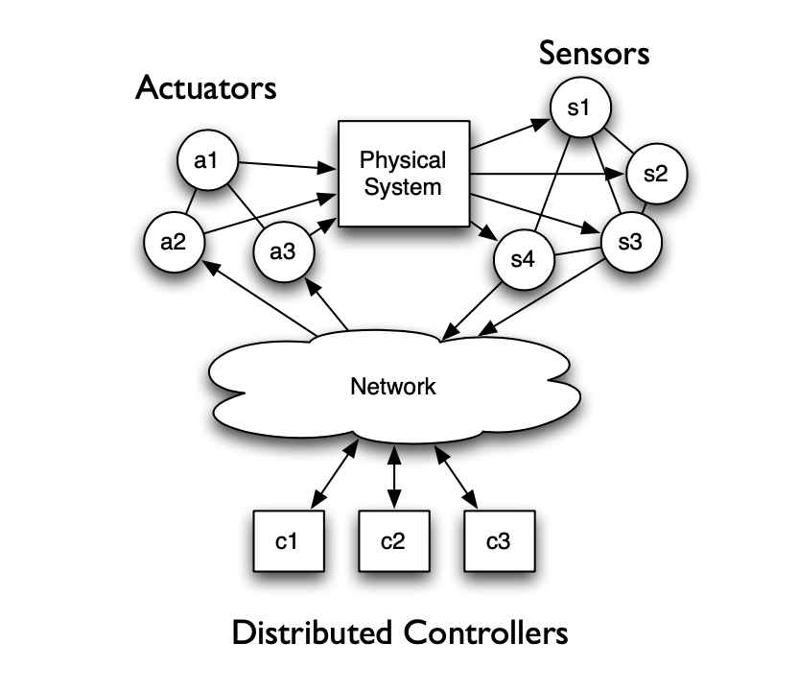
Characteristics of CPS
Embedded Systems: CPS does not need general purpose computing and full operating system – often it is just firmware
Real-Time Systems: Many CPS require real-time systems
Network protocols: raft of standards that are not particularly secure. Only just moving to IP-based protocols
Power: power and power supply a significant issue in CPS

Slide 15
CPS Cybersecurity Challenges
Attacks may result in physical harm, even death
Difficult to switch off devices or parts of the network
Default administrative ports left open with insecure protocols such as Telnet, FTP, TFTP, HTTP
Default manufacturer passwords used for administrative functions
Limited memory and processing
Asset lifetime is 15 – 20 years
Environmental threats

Slide 16
CPS Cybersecurity Challenges
No code signing or checking done on firmware updates
Communication is done unencrypted
Subject to injection attacks through malicious commands
Also vulnerable to all other types of attacks: malware, sniffing, spoofing, denial of service, etc.
Physical access to devices is hard to control

Slide 17
CPS Challenges: Updating Firmware
One of the main challenges of CPS is updating firmware, especially when this is done over-the-air (OTA)
Can use code signing to ensure the firmware update has not been tampered with and is from a trusted source
The device holds a public key for the update service
Individual files within the firmware update can be signed as well
Need a cryptographic bootloader to handle the loading and checking of firmware

Slide 18
CPS Cybersecurity Mitigation
Traditional protections through:
Firewalls
IDPS
Segregation of network
Access control – especially of remote access
Closing default administration ports and changing default passwords
Updating firmware through regular updates

Slide 19
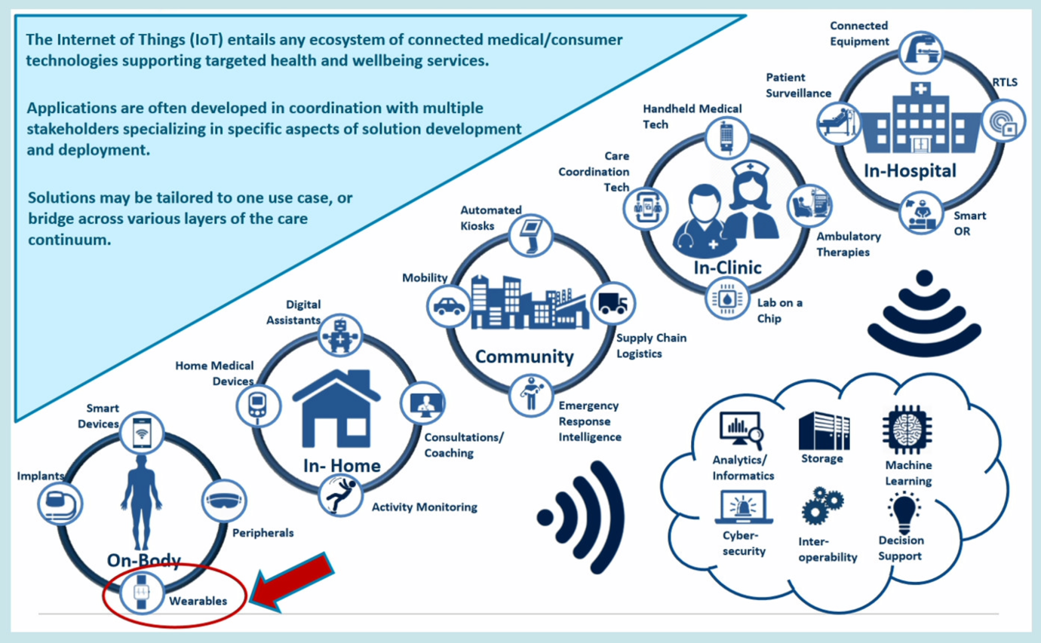
IoT in Healthcare
Frost and Sullivan Phillips

Slide 20
IoT Healthcare
Biggest area of use is in monitoring, including remote monitoring
New hospitals like Fiona Stanley and Perth Children’s Hospital in Perth WA have 50,000+ sensors that monitor environment, equipment, even bedding and uniforms. Robotic pharmacies and food delivery.
Ageing in place: allowing the elderly to stay in homes for longer
IoT are used to establish Activities of Daily Living and detect changes from the norm
Cardiac Implantable Electronic Devices (CIED): In the EU between 500,000 and 1 million devices a year are implanted
Monitor heart rate for arrythmias
Some are Bluetooth enabled to allow data upload to remote monitoring service
Consumer heart monitors like Smart Watches including arrythmia detection of Apple Watch and Garmin

Slide 21
IoT Healthcare: Risks
Privacy is probably the biggest risk with these devices
The ability to interfere with commands for insulin pumps or CIEDs to deliver fatal doses of insulin or an excessive charge (https://www.blackhat.com/us-18/briefings/schedule/#understanding-and-exploiting-implanted-medical-devices-11733)
Remote installation of firmware on devices
Attack software on phones or computer that allow data to be stolen, commands to be issued
Falsification of vital signs from monitors
Adversarial attacks on machine learning algorithms

Slide 22
IoT Healthcare: Mitigations
Manufacturers of healthcare devices are becoming more aware of security in their products
No longer dependent on network isolation or obscure protocols
Implementation of encryption and authentication on devices
Protection against ransomware attacks and applying other more general IT cybersecurity controls
Privacy protection through various means: differential privacy, homomorphic encryption, privacy spaces with edge devices (see Privacy lecture)

Slide 23
Cars
Modern cars may have 70+ electronic control units (ECU). Semi-autonomous cars like the Tesla also have ECUs (computers) to manage the self-driving. There is also a media control unit (MCU)
Communication in the car is via one or more CAN bus (Controller Area Network): control over engine and safety systems, one for lighting, user experience, one for parking systems, cruise control, lane guidance
CAN does not use encryption but has a Cyclic Redundancy Check (CRC) for message integrity
Can access the CAN via the On-Board Diagnostic (OBD) port
Cars are now also internet connected for remote monitoring against breakdowns, theft and there are remote control facilities available

Slide 24
Cars: Risks
Wireless key spoofing or other forms of attack to enter the vehicle and start the car
Spoofing sensors: e.g. 2010 researchers showed the ability to attack the Tire pressure monitoring systems of cars
Denial of service via OBD
Remotely controlling accelerator, breaks and steering (two hackers Miller and Valasek in 2016 on a Jeep Cherokee) – in one attack they wirelessly accessed the CAN bus and put the ECU into bootrom mode.
Disabling safety systems
Hacks on the remote monitoring systems such as OnStar
Accessing private information such as location data
Reading: Bozdal, et al (2020) Evaluation of CAN Bus Security Challenges https://www.ncbi.nlm.nih.gov/pmc/articles/PMC7219335/

Slide 25
Cars: Mitigations
Network segmentation: limit access to the end-user
Encryption
Authentication
Intrusion detection system
These mitigations come at increased cost and complexity and industry is reluctant to implement
Limited resources of processing and memory mean encryption and IDS are difficult to implement

Slide 26
The Essential Eight
Can implement Australian Signals Directorate (ASD) Essential Eight:
Application control: prevent the execution of unapproved/malicious programs
Configure Microsoft Office macro settings
Restrict administration privileges
Multi-factor Authentication
Daily backups
Patching applications
Application hardening
Patch Operating Systems

